Slide 1
Women Who Exercise
Torrey Capobianco
Bellevue University
Exploratory Data Analysis
Fall 2019

Slide 2
Hypothesis
Women who have children under the age of 18 exercise less than women who do not have children under the age of 18.

Slide 3
The Data
American Time Use Survey
2003-2015
US Bureau of Labor Statistics

Slide 4
Exercise Data
Who?
This analysis looks at exercise durations of females recorded in a single day.
What is considered exercise?
Durations recorded were taken from category “Participating in Sports, Exercise, and Recreation.” Due to this analysis looking at higher pace exercise activities, recreation activities such as playing billiards, fishing, hunting, vehicle touring/racing were removed from the data.

Slide 5
Variable Selection
Classification Variables
tucaseid:
case ID for respondent
tesex:
sex of respondent
trtier1p:
activity category 1st hierarchy
trtier2p:
activity category 2nd hierarchy
trcodep:
6 digit activity code
Analysis Variables
trchildnum:
number of children for respondent
tehruslt:
usual hours worked per week for respondent
tespuhrs:
usual hours worked per week for respondent's spouse
teage:
age of respondent
tuactdur24:
duration of activity in minutes

Slide 6
Histograms
Histograms and descriptive characteristics

Slide 7
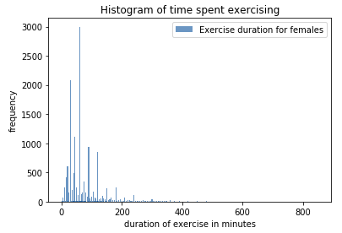
Time spent exercising
tuactdur24
Mean: 77.38 minutes
Mode: 60 minutes
Variance: 4676.86
Standard Deviation: 68.37
The histogram is left skewed with most of the time spent exercising in the left tail with the right tail extending far to the right.
Outliers: There are cases of recorded exercise up to 15 hours in a day. This seems unreasonable. For this analysis all records greater than 240 minutes or 4 hours is removed.

Slide 8
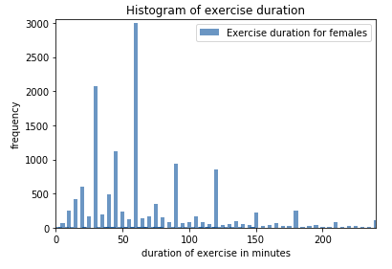
Time spent exercising
tuactdur24 – removed outliers
Mean: 68.51 minutes
Mode: 60 minutes
Variance: 2198.39
Standard Deviation: 46.89
The histogram is left skewed with most of the time spent exercising in the left tail with the right tail extending far to the right.

Slide 9
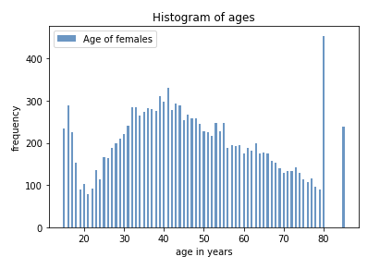
Age
teage
Mean: 46.96 years
Mode: 80 years
Variance: 326.58
Standard Deviation: 18.07
The histogram is multimodal, with a range with females less than their 20's, mid 40's, and the right tail their 80's.

Slide 10
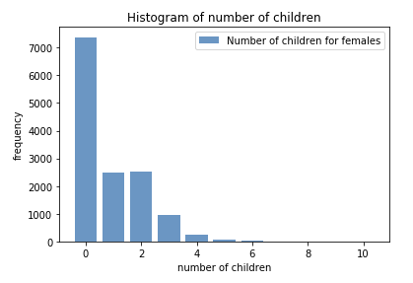
Number of children
trchildnum
Mean: 0.87 children
Mode: 0 children
Variance: 1.28
Standard Deviation: 1.13
The histogram is left negative skewed with a tail extending far to the right.

Slide 11
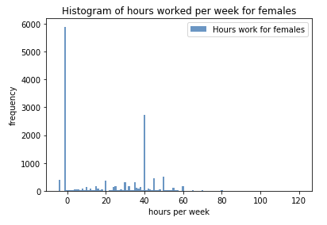
Usual hours work per week
tehruslt
Mean: 19.05 hours
Mode: -1 (does not work)
Variance: 443.08
Standard Deviation: 21.05
The histogram is binominal, with two peaks at -1 (does not work) and 40 hours.
Respondent answer of -4 indicates hours vary.
Respondent answer of -1 indicates does not work.

Slide 12
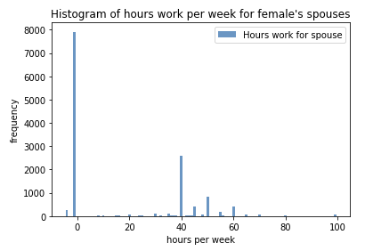
Usual hours work per week for spouse
tespuhrs
Mean: 17.33 hours
Mode: -1 (does not work)
Variance: 563.63
Standard Deviation: 23.74
The histogram is binominal, with two peaks at -1 (does not work) and 40 hours.
Respondent answer of -4 indicates hours vary.
Respondent answer of -1 indicates does not work.

Slide 13
Probability Mass Function
Comparing two scenarios with PMF

Slide 14
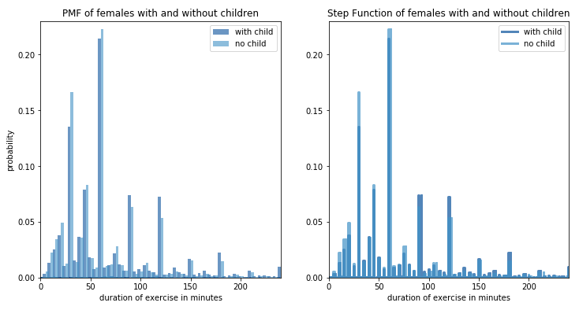
PMF of female exercise duration
Females with and without children
Exercise Duration | With Child | No Child
Mean | 73.34 | 64.36
Variance | 2401.37 | 1987.65
Standard Deviation | 49.00 | 44.58
The probability that females with children exercising for shorter durations is smaller than those without children. Compared to longer durations, they have a higher probability than those without children.

Slide 15
Cumulative Distribution Function
Comparing two scenarios with CDF

Slide 16
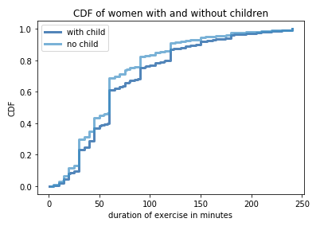
CDF of female exercise duration
Females with and without children
Exercise Duration | With Child | No Child
< 100 minutes | 78 % | 82 %
< 60 minutes | 60 % | 60 %
< 50 minutes | 39 % | 45 %
< 30 minutes | 25 % | 25 %
The CDF of exercise duration for females with children and no children are common in some durations. Once past 60 minutes, females without children have a higher cumulative probability of exercising more.

Slide 17
Analytical Distribution
Lognormal distribution

Slide 18
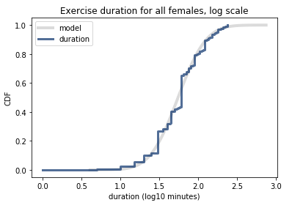
Lognormal Distribution
Exercise duration for all females
Lognormal distribution is the best fit for modeling the exercise duration of females.

Slide 19
Variable Relationships
Scatter plots, covariance, and correlation.

Slide 20
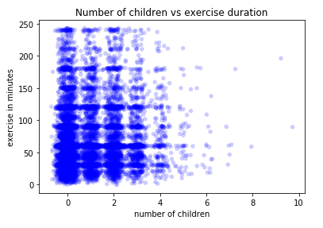
Number of children vs Exercise duration
Scatter Plot
 | Result | Interpretation
Covariance | 4.54 | Positive, variables move in the same direction
Pearson’s Correlation | 0.08 | Close to zero, no relationship between variables
Spearman’s Rank Correlation | 0.08 | Close to zero, no relationship between variables

Slide 21
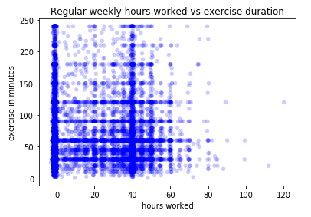
Number of hours work vs Exercise duration
Scatter Plot
 | Result | Interpretation
Covariance | -8.33 | Negative, variables move inversely
Pearson’s Correlation | -0.008 | Close to zero, no relationship between variables
Spearman’s Rank Correlation | 0.003 | Close to zero, no relationship between variables

Slide 22
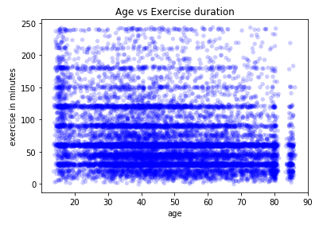
Age vs Exercise duration
Scatter Plot
 | Result | Interpretation
Covariance | -160.5 | Negative, variables move inversely
Pearson’s Correlation | -0.19 | Close to zero, no relationship between variables
Spearman’s Rank Correlation | -0.19 | Close to zero, no relationship between variables

Slide 23
Hypothesis Test
Permutation difference of the means.

Slide 24
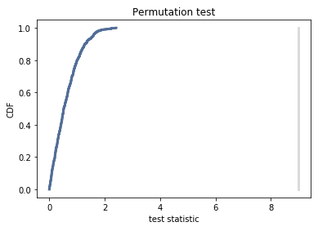
Women with children exercise less than those without
Null Hypothesis:
There is no difference in exercise habits between women with children under the age of 18 and women without children.
Permutation Difference of the Means:
P-Value: 0.0
Conclusion:
P-value is less than 1%. The effect is likely not due to chance.
Reject the null hypothesis
Accept the alternative hypothesis

Slide 25
Regression
Simple and multiple regression.

Slide 26
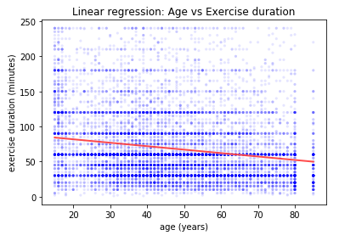
Simple Regression
Linear Least Squares:
Exercise duration as a function of age:
r-squared: 0.036
p-value: 0.00
Age accounts for 3.6% of exercise duration in females.

Slide 27
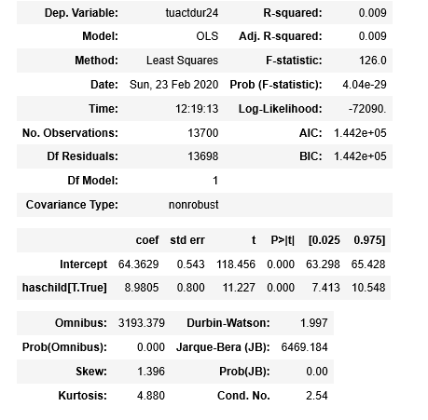
Simple Regression
Exercise duration as a function of having a child:
r-squared: 0.009
Having a child accounts for 0.9% of exercise duration in females.
p-value: 0.00
This effect is likely to not occur by chance.

Slide 28
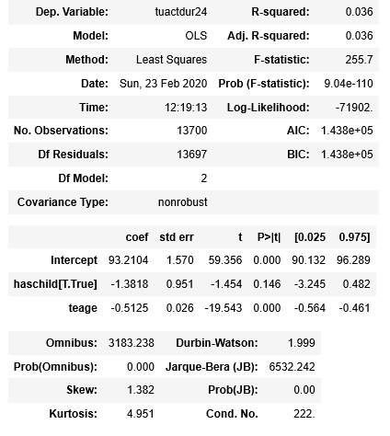
Multiple Regression
Exercise duration as a function of having a child and age:
r-squared: 0.036
r-squared increased to 3.6% accountability with adding age.
p-value has child: 0.146 p-value age: 0.00
The effect of age is likely to not occur by chance.
Having a child > .05 results not being statistically significant. This does not have an affect in determining exercise when age is involved.

Slide 29
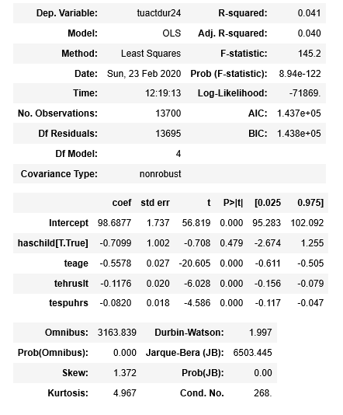
Multiple Regression
Exercise duration as a function of having children, age, hours work per week for self and for spouse:
r-squared: 0.041
r-squared increased to 4.1% accountability with adding hours work per week for self and spouse.
p-value has child: 0.479 p-value all others: 0.00
The effect of all others but having a child are likely to not occur by chance. Having a child has no affect on exercise duration with a p-value greater than 0.05.

Slide 30
Conclusion
Through comparison of CDF, hypothesis testing, and simple regression, women’s exercise habits are different with those that have children under the age of 18 and those that do not. Those with children exercise less than those that do not have children. However, when looking at multiple regression, other variables account for female exercise habits that do not involve having children.

Slide 31
Resources
DeJesus, John. (2019). What, Why, and How to Read Empirical CDF. Towards Data Science. Retrieved from https://towardsdatascience.com/what-why-and-how-to-read-empirical-cdf-123e2b922480
Downey, A. B. (2015). Think Stats: Exploratory Data Analysis (2nd ed.). Sebastopol, CA: O’Reilly Media Inc.
Minitab Blog Editor. (2013). How to Interpret Regression Analysis Results: P-values and Coefficients. Retrieved from https://blog.minitab.com/blog/adventures-in-statistics-2/how-to-interpret-regression-analysis-results-p-values-and-coefficients
Pathak, Manish. (2018). Joining DataFrames in Pandas. DataCamp. Retrieved from https://www.datacamp.com/community/tutorials/joining-dataframes-pandas
U.S. Bureau of Labor Statistics. (2017). American Time Use Survey: Multi-Year Survey Microdata Files from 2003-2015. Retrieved from https://www.kaggle.com/bls/american-time-use-survey/data
VanderPlas, J. (2016). Python Data Science Handbook: Essential tools for Working with Data (1st ed.). O’Reilly Media Inc.

